Slide 1
UG Data- Set Survey Questions
Sample Answers to Questions.

Slide 2
Report Contents
Short managerial report describing the sample
95% confidence intervals for Mean GPA, Mean Salary, Mean Spending, Mean Wealth for the Overall sample, Females and Males
Hypothesis testing for the specific scenarios

Slide 3
I. Sample report

Slide 4
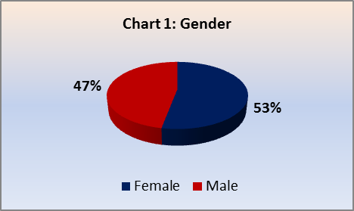
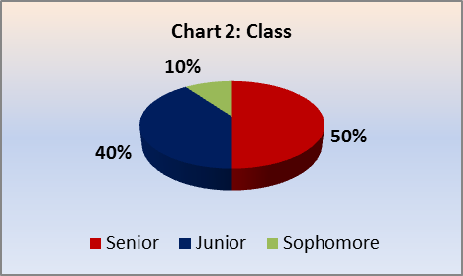
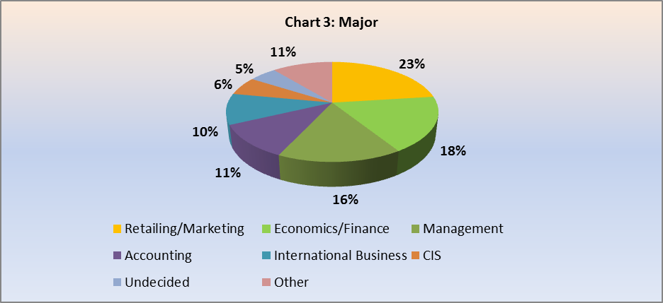
Description of data along different categories
Females are in majority accounting for 53% of the class. The remaining 47% are males. (Chart1)
If observe Student distribution across year of study, we observe that 50% students are seniors and 40% are juniors whereas 10% are sophomores. (Chart 2)
Maximum numbers of students have opted for retailing/marketing as a major with 23%. It is followed by economics/finance with 18% and management with 16%. Next is accounting with 11% followed by international business with a share of 10%. (Chart 3)

Slide 5
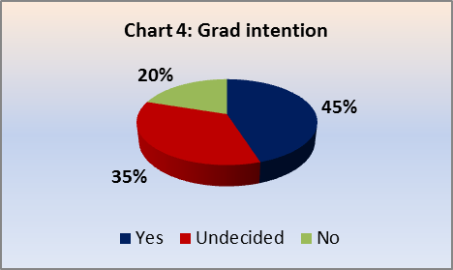
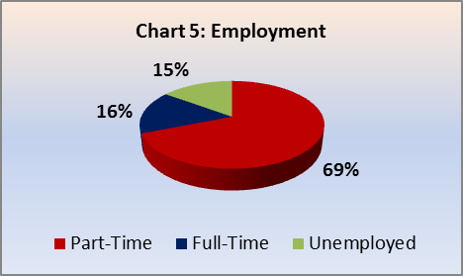
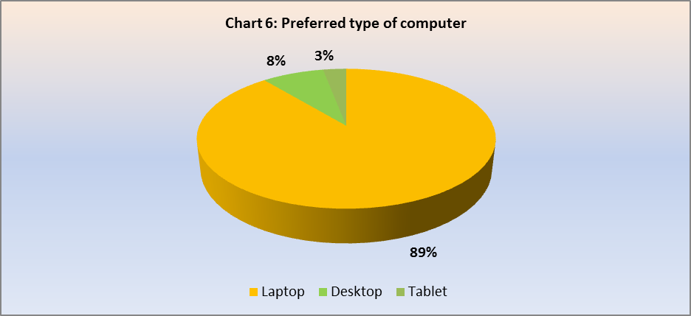
Description of data along different categories
As far as intention of students post UG studies is concerned, 45% of students want to go for graduate studies and 19% do not want to for graduate studies whereas 35% haven’t decided yet (Chart 4)
When we look at the employment profile, 69% are involved in part-time employment and 16% are working full time, while the remaining 15% are unemployed. (Chart 5)
Laptop is the most preferred type of computer with 89% choosing it, 8% prefer desktop while only 3% prefer tablet. (Chart 6)

Slide 6
Description of data along different measures
Mean age of the sample is 21.1 years while median and mode age is 21. The age of the students ranges between 18 to 26 years.
Mean GPA of the class is 3.1 (on a scale of 1-4) while standard deviation is 0.4 showing lesser variation. Highest GPA is 3.9 while lowest is 2.3.
Mean salary expectation of the students is 50000 US $, with a standard deviation of 12.1. Salary expectation ranges between 25000 US $ and 800000 US $.
Maximum numbers of students are registered at least on 1 social networking site. Some of them aren’t registered to any while few of them are registered on 4. Mean registration is 1.5 while median is 1.
 | MEAN | MEDIAN | MODE | ST.DEV | VARIANCE | MIN | MAX | RANGE
Age (Years) | 21.1 | 21.0 | 21.0 | 1.4 | 2.0 | 18.0 | 26.0 | 8.0
GPA (1- 4 Scale) | 3.1 | 3.1 | 3.4 | 0.4 | 0.1 | 2.3 | 3.9 | 1.6
Salary expectation (Thousand US $) | 48.5 | 50.0 | 40.0 | 12.1 | 145.9 | 25.0 | 80.0 | 55.0
Social Networking | 1.5 | 1.0 | 1.0 | 0.8 | 0.7 | 0.0 | 4.0 | 4.0

Slide 7
Description of data along different measures
Mean satisfaction level with food and dining services in campus is 3.7 which are slightly higher than the mid-point. Median and mode both are 4. Least is 1 while highest is 6 indicating the high variability in satisfaction level.
The average spending on textbooks and supplies in current semester was recorded at 482 $ (SD = 222) with high dispersion in data, showing the high varied spending habits among students. This is also evident by the range which is 1,300.
The weekly average number of messages also shows a high variation. Mean number of text messages sent is 246.2 (SD=214.5). The least number of messages sent is 0 while highest goes as far as 900 messages.
Perception of being rich varies widely among students. While mean is 7.2 million US $ (SD= 19.6) which explains benchmark set by students for richness is highly differential. The lowest is 0.1 million US $ while highest goes as far as 100 million US $. Though most of the students fall around 1 million US $ (Median and mode both are 1 million).
 | MEAN | MEDIAN | MODE | ST.DEV | VARIANCE | MIN | MAX | RANGE
Satisfaction | 3.7 | 4.0 | 4.0 | 1.2 | 1.5 | 1.0 | 6.0 | 5.0
Spending ( US $) | 482.0 | 500.0 | 500.0 | 222.0 | 49263.5 | 100.0 | 1400.0 | 1300.0
Text Messages | 246.2 | 200.0 | 300.0 | 214.5 | 45995.6 | 0.0 | 900.0 | 900.0
Wealth (Million US $) | 7.1 | 1.0 | 1.0 | 19.6 | 384.5 | 0.1 | 100.0 | 99.9

Slide 8
II. Constructing 95% confidence intervals

Slide 9
Distribution of GPA and Assumption of Normality
The Histogram implies that GPA data is left- skewed and from NPP we understand that data can be assumed to be normal with few reservations

Slide 10
Confidence intervals for Mean GPA
The analysis of means for GPA shows that the mean GPA for females is higher than the overall and males . The lower bound for Male Mean GPA is much lower than that of females and overall

Slide 11
Distribution of Salary and Assumption of Normality
The Histogram implies that Salary data is multi-modal and from NPP we understand that data can be assumed to be normal with few reservations and we may actually have to take α > 0.05 to ensure that population parameter falls within confidence interval

Slide 12
Confidence intervals for Mean Salary
The analysis of means shows that the mean salary for females is almost similar to males. However, the upper bound for Female mean salary is higher than that of males and overall.

Slide 13
Distribution of Spending and Assumption of Normality
The Histogram implies that Spending data is Right Skewed with good number of outliers and from NPP we understand that data can be assumed to be normal with few reservations and we may actually have to take α > 0.05 to ensure that population parameter falls within confidence interval

Slide 14
Confidence intervals for Mean Spending
The analysis of means shows that the mean spending on textbooks and supplies is higher for males as compared to females and overall. The lower and upper bound for female mean spending is much lower than that of males and overall.

Slide 15
Distribution of Wealth and Assumption of Normality
The Histogram implies that Wealth data is heavily Right Skewed with high number of outliers and from NPP we understand that data can be it should not be assumed to be normal actually and In fact we may actually have go median as a central measure to ensure that population parameter falls within confidence interval

Slide 16
Confidence intervals for Mean Wealth
The analysis of means shows that the benchmark for wealth accumulation to be considered rich is much higher for males as compared to females. The lower and upper bound for female mean wealth is much lower than that of males and overall. Moreover Instead of mean, Median will the right measure for a such a heavily dispersed data

Slide 17
III. Hypothesis testing for the specific scenarios

Slide 18
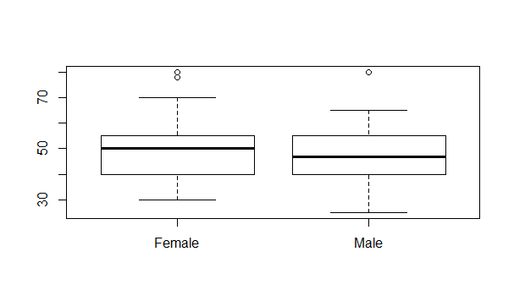
Salary expectation for male undergraduates is higher than salary expectation for female
Mean Salary Expectation of Male undergraduates: U1
Mean Salary Expectation of Female undergraduates: U2
Null hypothesis: U1 >= U2
Alternative hypothesis: U1 < U2
F Test shows that:
F-stat: 0.6613 > F-Critical: 0.5385. So, variances are not equal.
R code:
> males <- subset(UndergradSurvey, Gender=='Male')
> females <- subset(UndergradSurvey, Gender=='Female')
> t.test(males$Salary,females$Salary, mu=0,alternative="less",paired=FALSE,var.equal=FALSE,conf.level=0.95)
Result of t-test
t = -0.1674, df = 59.667, p-value = 0.4338
alternative hypothesis: true difference in means is less than 0
Boxplot of salary w.r.t gender
Conclusion
Here, P-Value (0.4338) is > α (0.05)
Thus at 95% confidence interval, a t test (assuming unequal variances) failed to reveal sufficient evidence to reject the claim that “Mean Salary expectation for male undergraduates is higher than the mean salary expectation for female undergraduates”. Hence we accept the null hypothesis

Slide 19
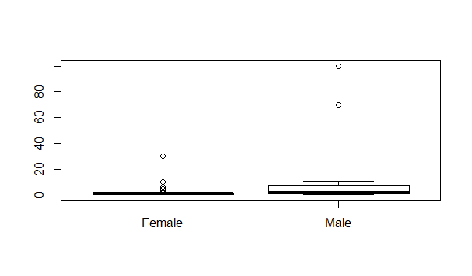
Males will consider themselves rich with significantly higher wealth accumulation compared to females
Mean wealth accumulation benchmark of Male undergraduates: U1
Mean wealth accumulation benchmark Female undergraduates: U2
Null hypothesis: U1 >= U2
Alternative hypothesis: U1 < U2
F Test shows that:
F-stat: 26.0323 > F-Critical: 1.8302
So, variances are not equal.
R Code:
> t.test(males$Wealth ,females$Wealth, mu=0,alternative="less",paired=FALSE,var.equal=FALSE,conf.level=0.95)
Result of t-test
t = 1.9656, df = 29.893, p-value = 0.9706
alternative hypothesis: true difference in means is less than 0
Boxplot of wealth w.r.t gender
Conclusion
Here, P-Value (0.9706) is > α (0.05)
Thus at 95% confidence interval, a t test (assuming unequal variances) failed to reveal sufficient evidence to reject the claim that “Mean Wealth accumulation for Males to consider themselves as rich is greater than that of females”. Hence we accept the null hypothesis

Slide 20
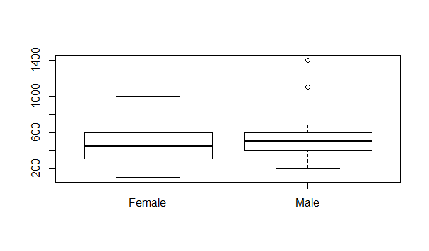
Females spend significantly less on textbooks and supplies compared to males
Mean spending of female undergraduates on text books: U1
Mean spending of male undergraduates on text books: U2
Null hypothesis: U1 <= U2
Alternative hypothesis: U1 > U2
F Test shows that:
F-stat: 1.3675 < F-Critical: 1.8302
So, variances are equal. We go for a pooled test
R code:
> t.test(females$Spending ,males$Spending, mu=0,alternative="greater",paired=FALSE,var.equal=TRUE,conf.level=0.95)
Result of t-test
t = -1.134, df = 60, p-value = 0.8693
alternative hypothesis: true difference in means is greater than 0
Boxplot of spending w.r.t gender
Conclusion
Here, P-Value (0.8693) is > α (0.05)
Thus at 95% confidence interval, a t test (assuming equal variances) failed to reveal sufficient evidence to reject the null hypothesis that “Mean spending of female undergraduates is less than the mean spending of male undergraduates”. Hence we accept the null hypothesis.

Slide 21
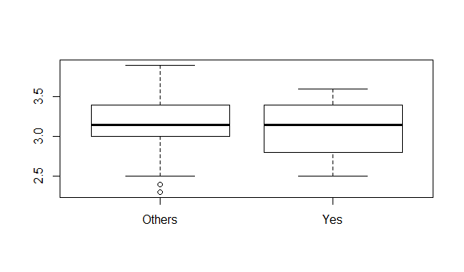
Undergraduates who decided to go for graduate studies have a significantly higher GPA than others
Mean GPA of decided undergraduates: U1
Mean spending of other undergraduates: U2
Null hypothesis: U1 >= U2
Alternative hypothesis: U1 < U2
F Test shows that:
F-stat: 0.8329 < F-Critical: 0.5385. So, variances are equal. We go for a pooled test
R Code
> Grad_Inten_Y <- subset(UndergradSurvey, `Grad Intention` =='Yes')
> Grad_Inten_O <- subset(UndergradSurvey, `Grad Intention` != 'Yes')
> t.test(Grad_Inten_Y$GPA ,Grad_Inten_O$GPA, mu=0,alternative="less",paired=FALSE,var.equal=TRUE,conf.level=0.95)
Result of t-test
t = -0.91346, df = 60, p-value = 0.1823
alternative hypothesis: true difference in means is less than 0
Boxplot of GPA w.r.t grad intention
Conclusion
Here, P-Value (0.1823) is > α (0.05)
Thus at 95% confidence interval, a t test (assuming equal variances) failed to reveal sufficient evidence to reject the null hypothesis that “Mean GPA for students who have decided to go for graduate studies (grad intention Yes) is higher than others”. Hence we accept null hypothesis

Slide 22
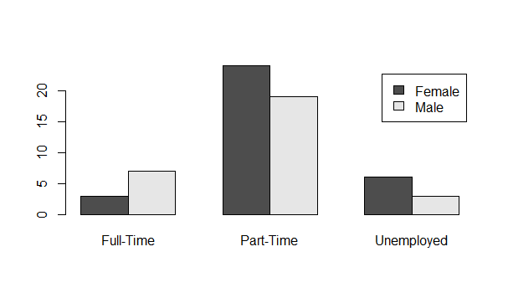
Employment status is independent of gender
Null hypothesis: Employment status is independent of Gender
Alternative hypothesis: Employment status depends on Gender
Bar plot of employment vs gender
Result of chi-square test
data: tab1
X-squared = 2.9355, df = 2, p-value = 0.2304
Conclusion
Here, P-Value (0.2304) is > α (0.05)
Thus at 95% confidence interval, a chi-square test failed to reveal sufficient evidence to reject the claim that “Employment status is independent of Gender”. Hence, employment status is independent of gender.

Slide 23
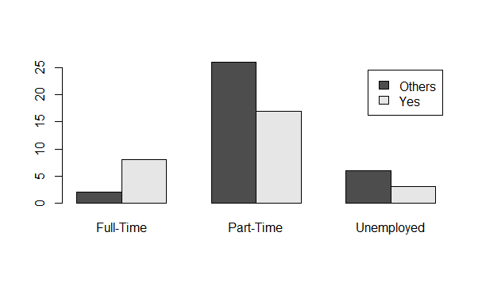
Employment status is independent of Grad Intention
Null hypothesis: Employment status is independent of Grad Intention
Alternative hypothesis: Employment status depends on Gender Intention
Bar plot of employment vs grad intention
Result of chi-square test
data: tab2
X-squared = 5.9589, df = 2, p-value = 0.05082
Conclusion
Here, P-Value (0.05082) is > α (0.05)
Thus at 95% confidence interval, a chi-square test failed to reveal sufficient evidence to reject the claim that “Employment status is independent of Gender”. Hence employment status is independent of Grad Intention.
However the p-value is only slightly greater than 0.05. So this case needs to be studied further.

